Slide 1
FOR LOOP

Slide 2
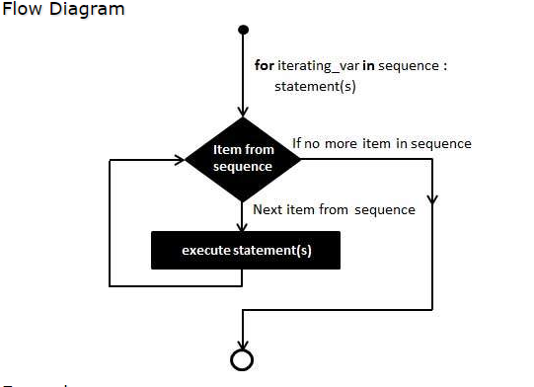
For Loop
It has the ability to iterate over the items of any sequence, such as a list or a string.

Slide 3
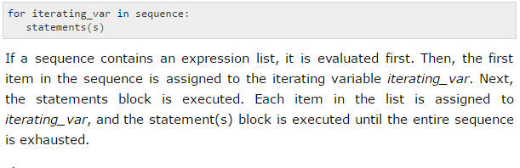
Syntax

Slide 4

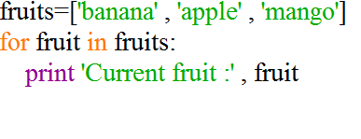
Example

Slide 5
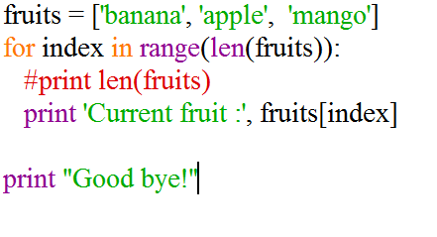
Iterating by Sequence Index
An alternative way of iterating through each item is by index offset into the sequence itself.

Slide 6
Continue..
len() built-in function, which provides the total number of elements in the tuple.
range() built-in function to give us the actual sequence to iterate over.

Slide 7
Using else Statement with Loops
Python supports to have an else statement associated with a loop statement
If the else statement is used with a for loop, the else statement is executed when the loop has exhausted iterating the list.
If the else statement is used with a while loop, the else statement is executed when the condition becomes false.

Slide 8
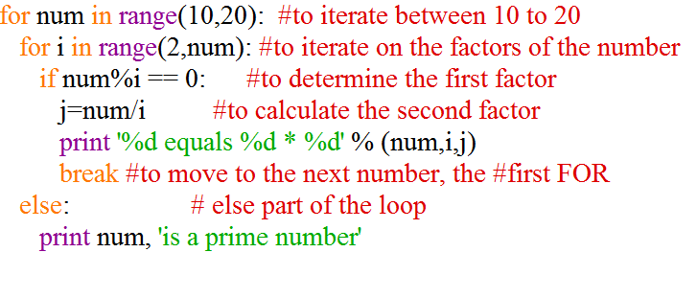
Example

Slide 9
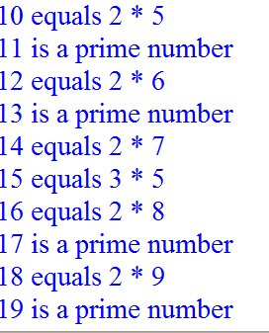
Output

